Slide 1

Overview of Real-Time Computer Graphics
CS 498: Virtual Reality
UNIVERSITY OF ILLINOIS AT URBANA-CHAMPAIGN
Eric Shaffer

Slide 2
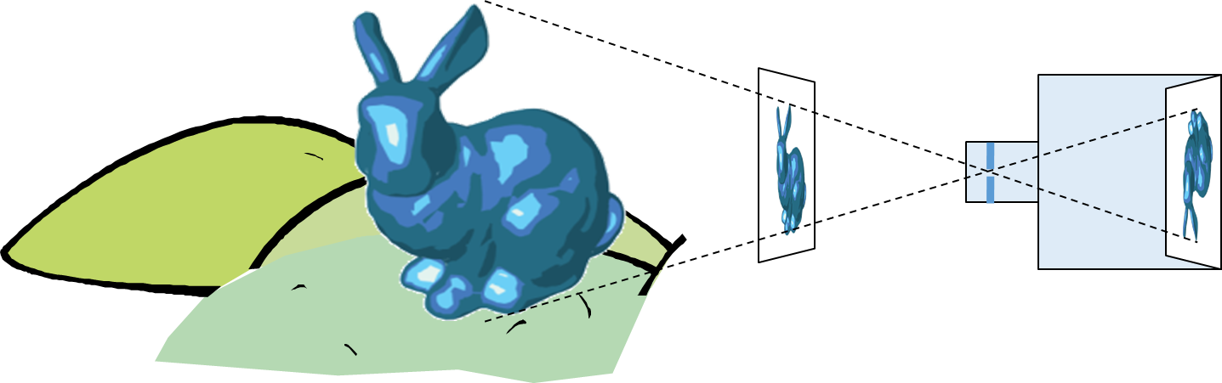
3D Graphics: Image Formation
Goal in CG is to generate a 2D image of a 3D scene…
The input data is a scene description
Output is an image
One approach is to computationally mimic a camera or human eye
In the scene…there are objects…lights…and a viewer

Slide 3
“Chlorophyll”
Light is EM radiation
Usually multiple wavelengths
mixed together in a power spectrum
The spectrum sensed by our eyes gets modified multiple times.
Human perception of color relies on 3 different cell types that sense different regions of the spectrum

Slide 4

Rendering or image synthesis is the automatic process of generating a photorealistic or non-photorealistic image from a 2D or 3D mode l
Rendering methods generally use one of two approaches
Rasterization (focus of CS 418)
Ray Tracing (focus of CS 419)
Though, sometimes you can use both….
…and the are other methods like radiosity
By Gilles Tran - http://www.oyonale.com/modeles.php?lan

Slide 5

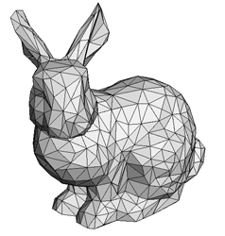
Pixel Discretization

Slide 6
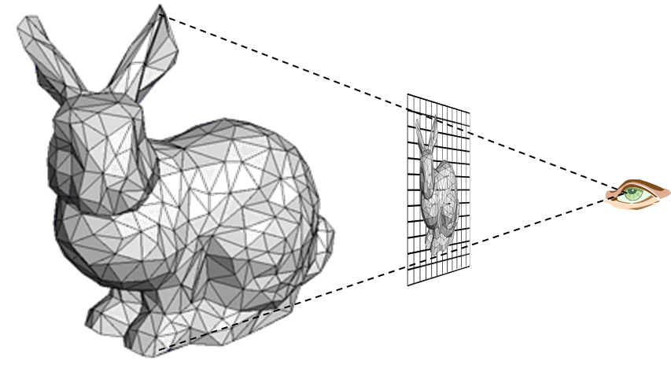
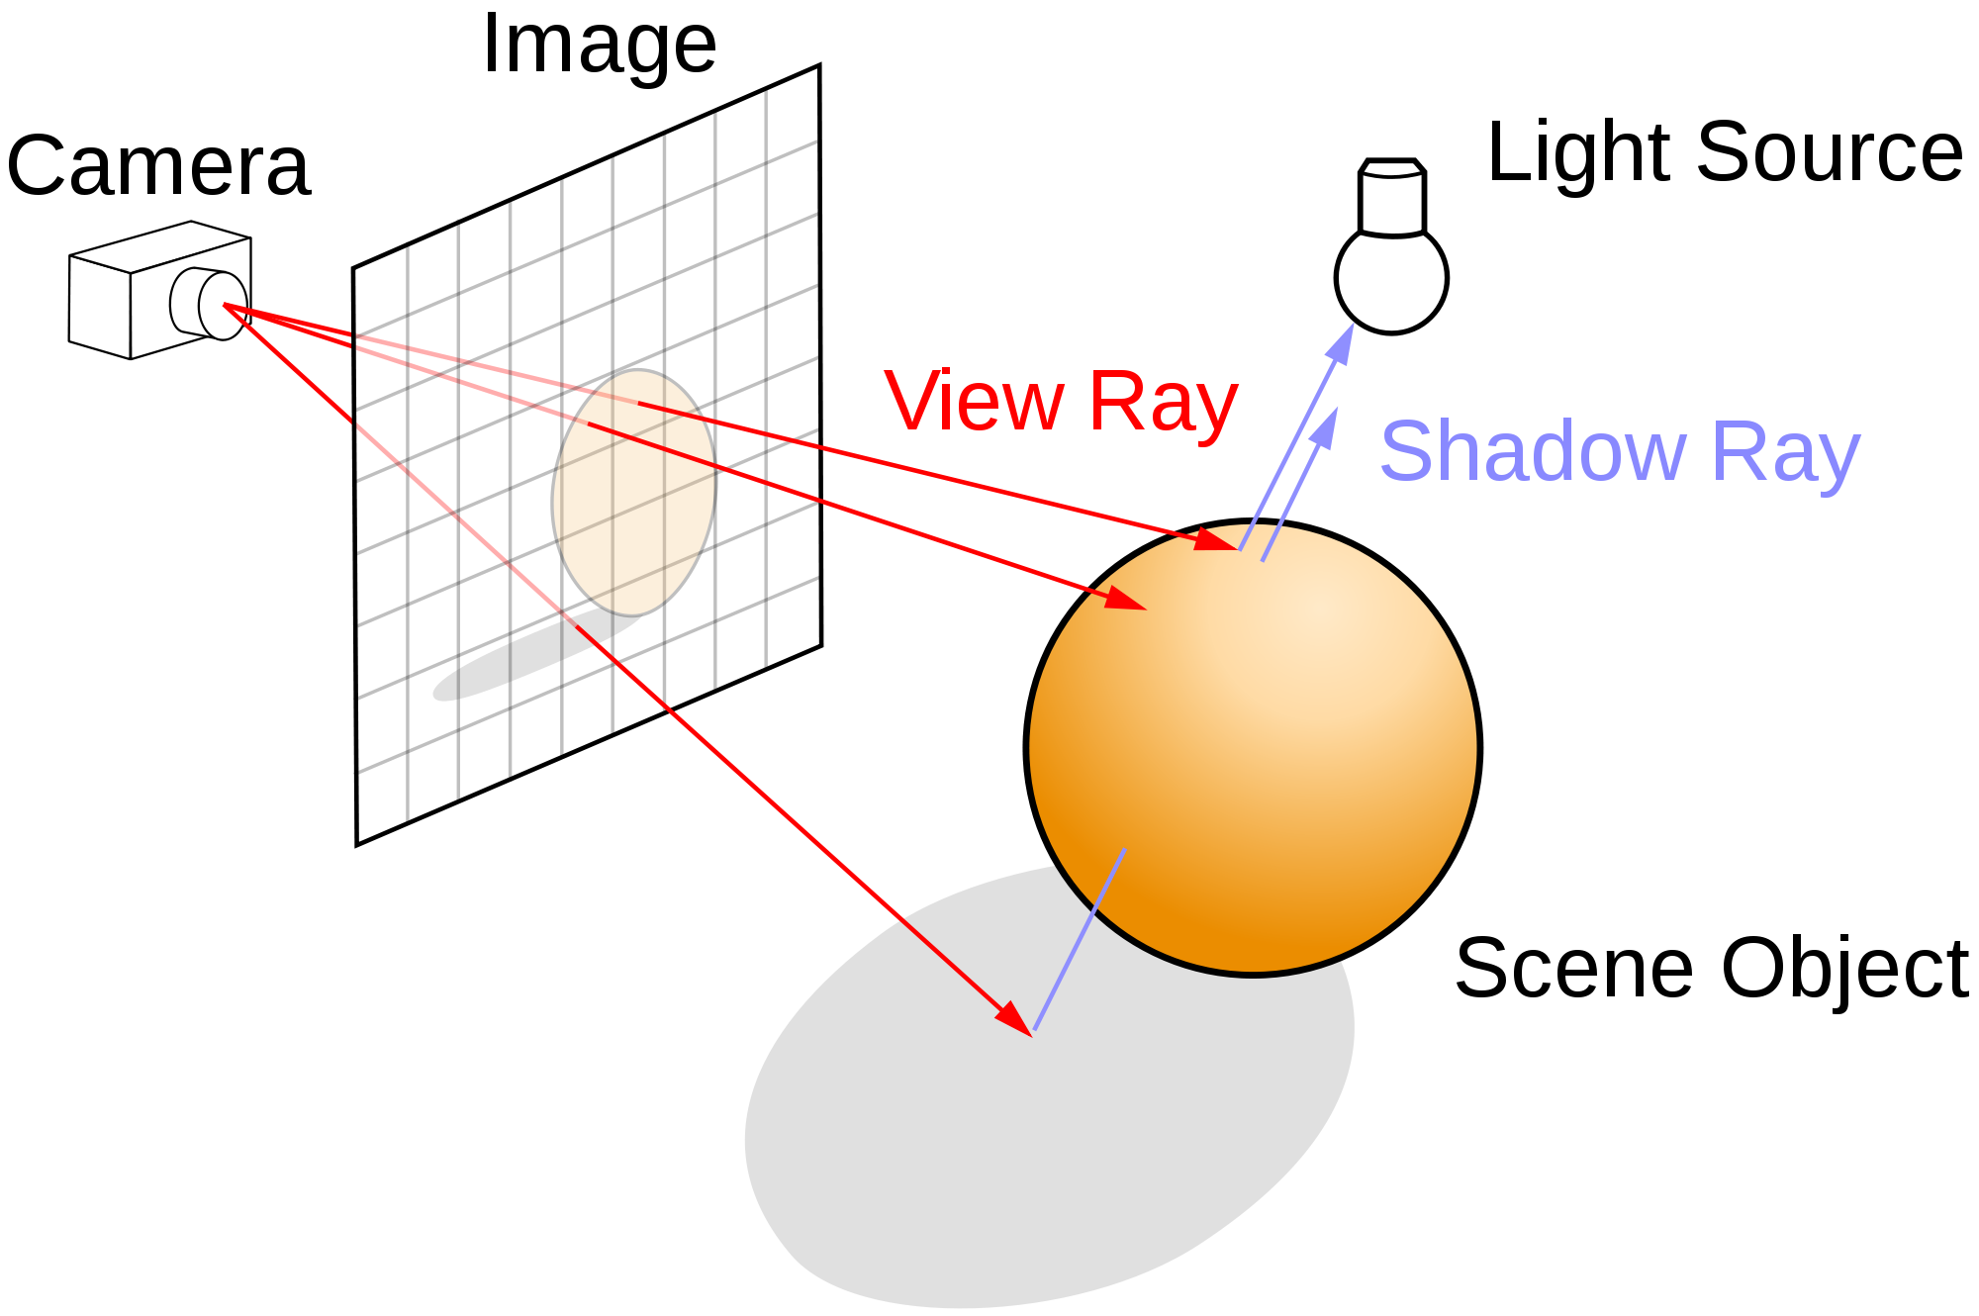
Rasterization versus Ray Tracing
To oversimplify….
In rasterization, geometric primitives are projected onto an image plane and the rasterizer figures out which pixels get filled.
In ray-tracing, we model the physical transport of light by shooting a sampling ray though each pixel in an image plane and seeing what the ray hits in the scene

Slide 7
Ray Tracing
Follow ray of light….
Can trace from an eyepoint through a pixel
See what object the ray hits…
How would you check to see if the object is lit?

Slide 8
Rasterization
For each primitive:
Compute illumination
Project to image plane
Fill in pixels

Slide 9

Global versus Local Illumination
For true photo-realism: We cannot compute color or shade of each object independently
Why?

Slide 10
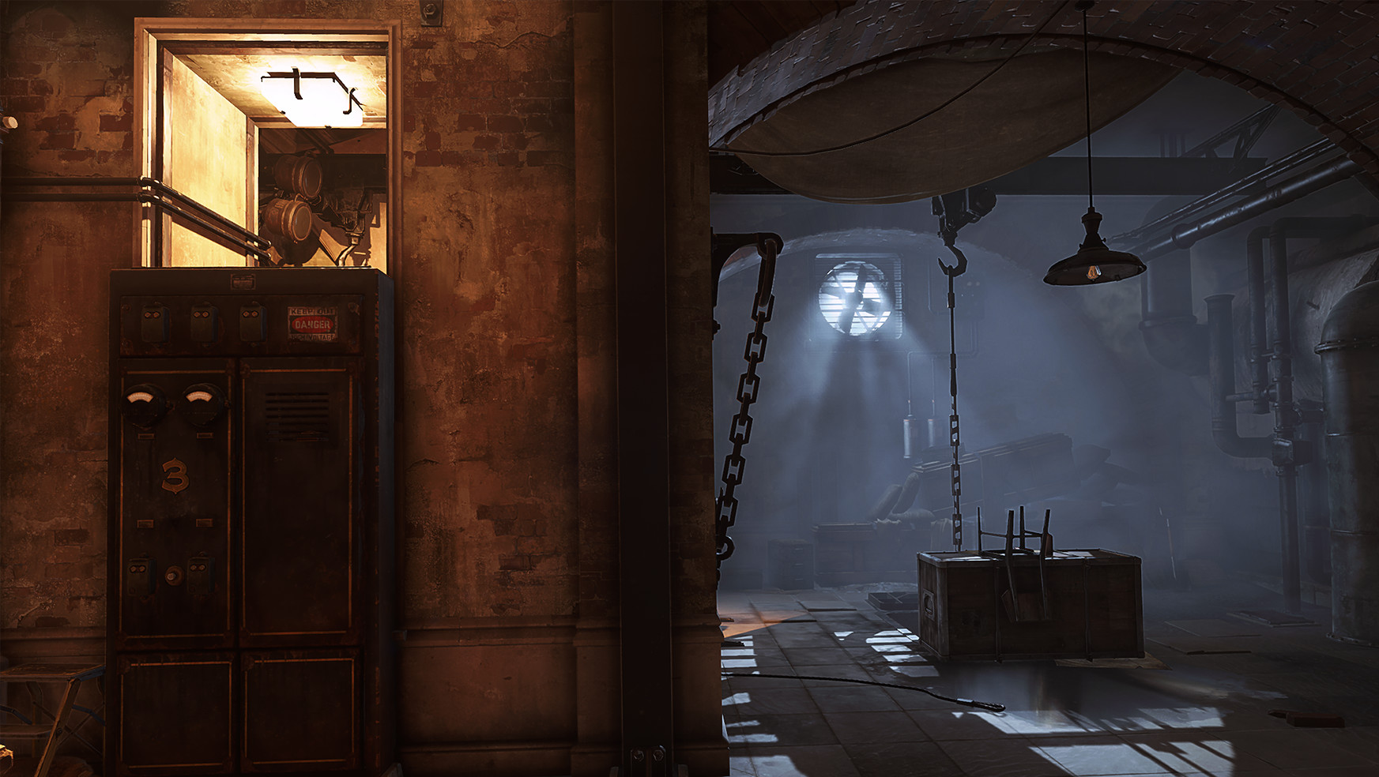
Some objects are blocked from light
Light can reflect from object to object
Some objects might be translucent
Can rasterization produce global lighting effects?
Can ray tracing?
The big advantage of rasterization is…?

Slide 11
Rasterization Engines

Slide 12
Definitions: Pixel and Raster
Unity uses 3 floats in [0,1] to represent a color. Not all systems do…some use integers in [0,255]…some use special representations like RGBE to achieve High Dynamic Range.
A pixel is the smallest controllable picture element in an image
A raster is a grid of pixel values
Typically rectangular grid of color values
(1.0, 0.0, 0.0), (0.0, 0.0, 1.0)
(0.0, 0.0, 1.0), (1.0, 0.0, 0.0)
RGB Color Representation A color is a triple (R,G,B) representing a mix of red, green, and blue light. Each color channel has a value in [0, 1] indicating how much light is emitted.

Slide 13


3D Graphics Pipeline
Vertex Processing
Rasterization
Fragment Processing
Fragments Are like pixels…but they aren’t necessarily the finalized pixels you see in an image.
Each fragment has a 2D location in a raster and a color. Final pixel value is typically found by applying hidden surface removal and possibly compositing to a set of fragments.

Slide 14
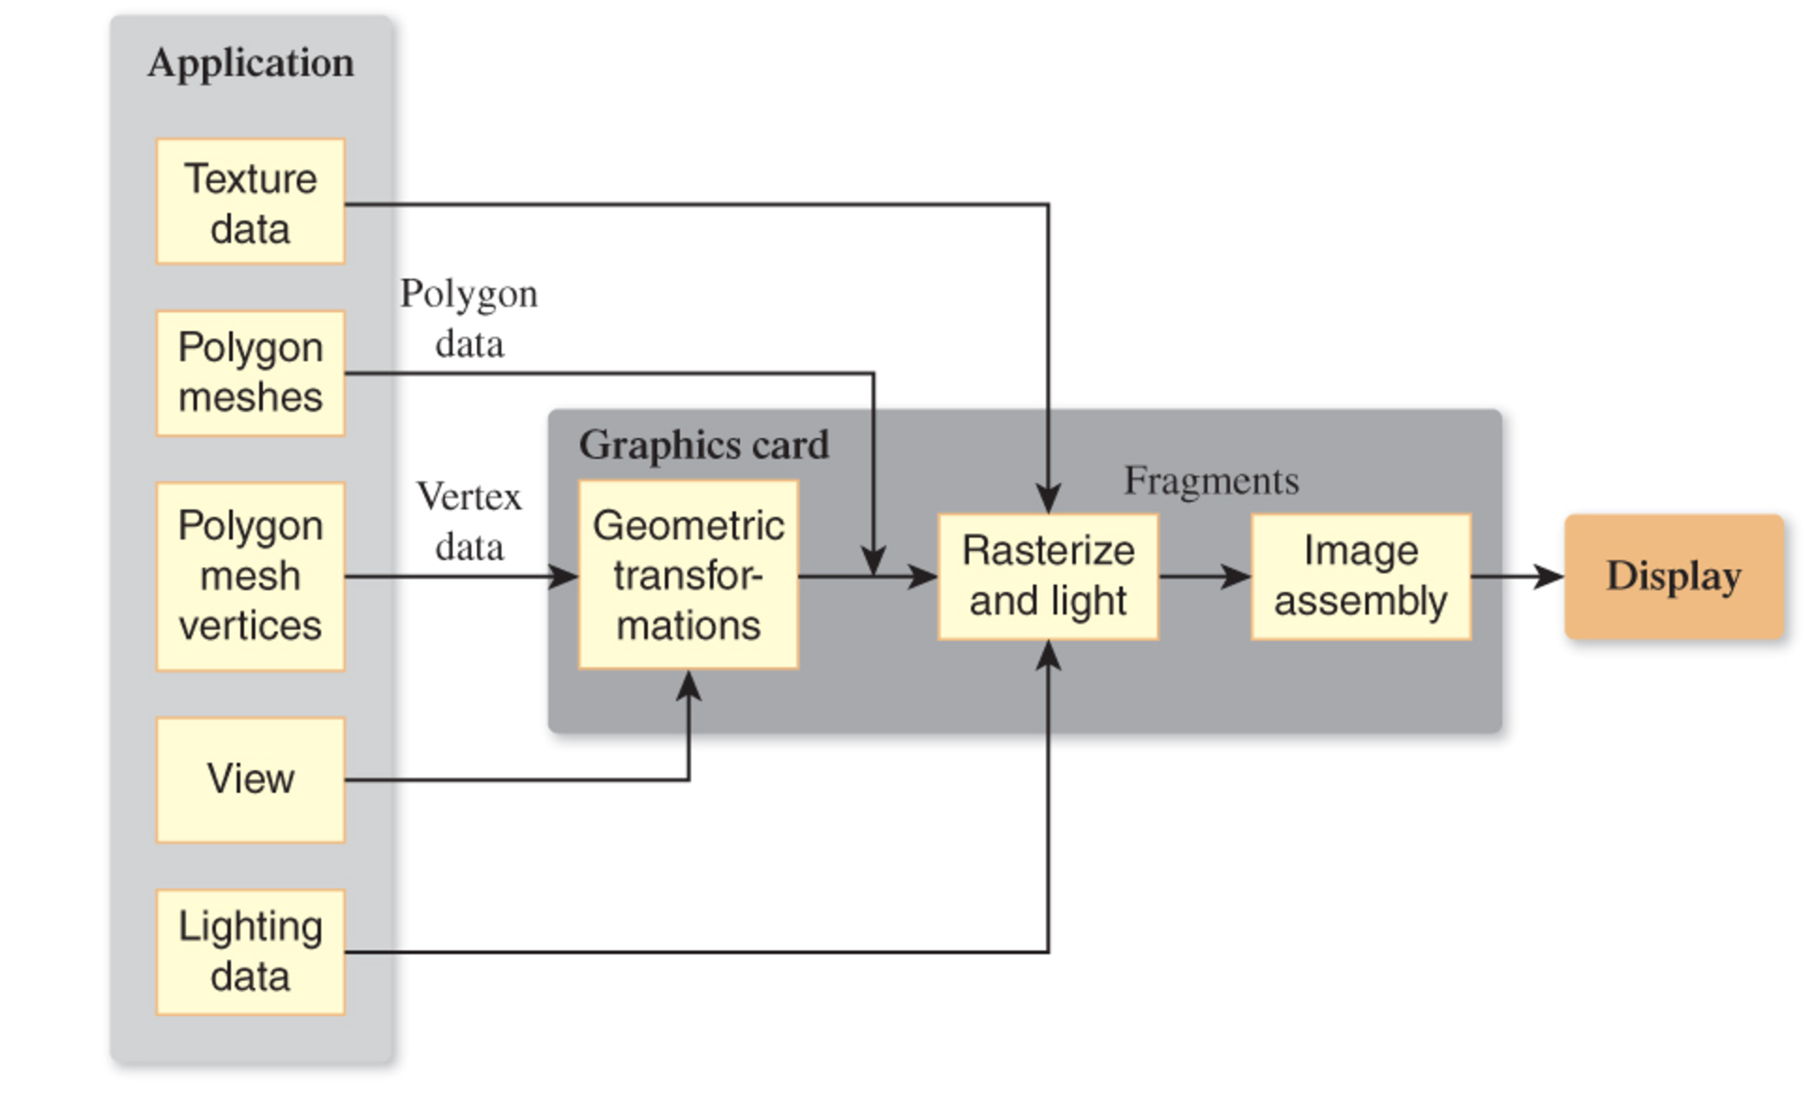
Rasterization is a Pipeline
Data for objects in the scene usually in the form of polygonal meshes
Most of the work to render an image is done on the Graphics Processing Unit (GPU)
GPU code will have at least two parts
Vertex Shader
Fragment Shader

Slide 15
Pipeline of Transformations

Slide 16
Graphics Pipeline
Model Coords
Model Xform
World Coords
Viewing Xform
Viewing Coords
Perspective Distortion
Homogeneous Divide
Still Clip Coords.
Clipping
Clip Coords.
Window
Coordinates
Window
to
Viewport
Viewport
Coordinates

Slide 17
Graphics Pipeline
Model Coords
Model Xform
World Coords
Viewing Xform
Viewing Coords
Perspective Distortion
Homogeneous Divide
Still Clip Coords.
Clipping
Clip Coords.
Window
Coordinates
Window
to
Viewport
Viewport
Coordinates
M

Slide 18
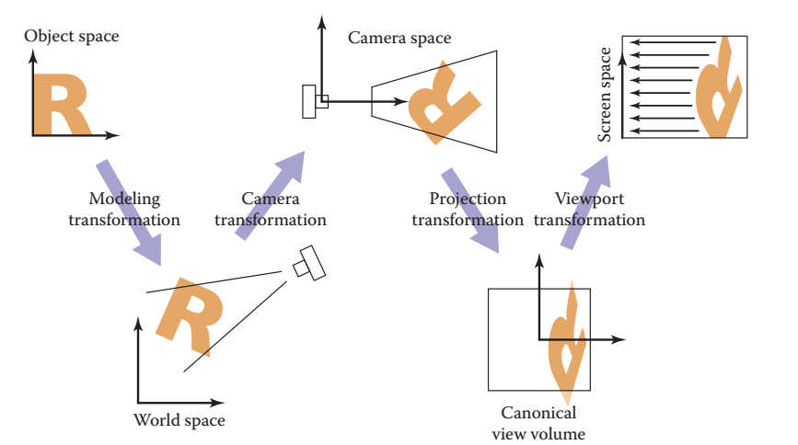
Modeling Transformation
Pretty simple…models are created in model coordinates
Often centered on the origin
A Modeling Transformation
Moves the model into the correct spot in the World
It can be any combination of affine transformations
You will sometimes hear “camera transformation” called “view transformation”. And “camera space” called “view space”

Slide 19
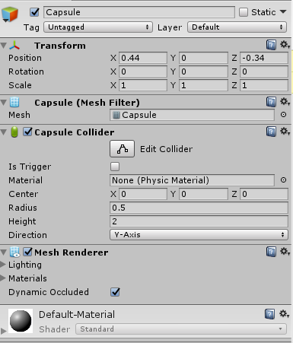
Modeling Transformation
Here’s a 3D mesh object from Unity
The information in the Transform box is used to create a Model matrix
This transformation is applied to all the vertices of the mesh

Slide 20
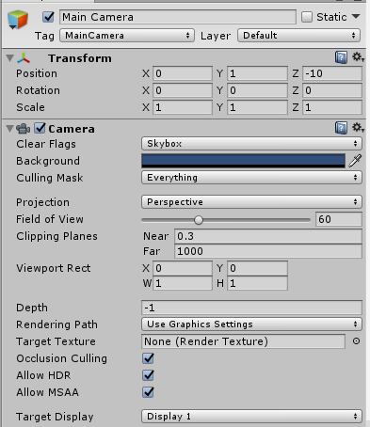
Virtual Cameras
This is a Camera from Unity…it generates a view of the virtual world
This accomplished mostly by applying matrix transformations to geometry
The information in the Transform box is used to create a View matrix
Projection and Field of View and Clipping planes create a Projection matrix
Viewport Rect is used to create Viewport matrix

Slide 21
Viewing
We often will want to allow the view of our 3D scene to change
We can do so using by applying affine transformations to the geometry
A view matrix is functionally equivalent to a camera It is a transformation matrix like the Model matrix, but
Happens after the modeling transformation
It applies the same transformations equally to every object
Moving the whole world 5 units towards us = walking 5 units forwards
“The engines don’t move the ship at all. The ship stays where it is and the engines move the universe around it.”
-- Futurama

Slide 22
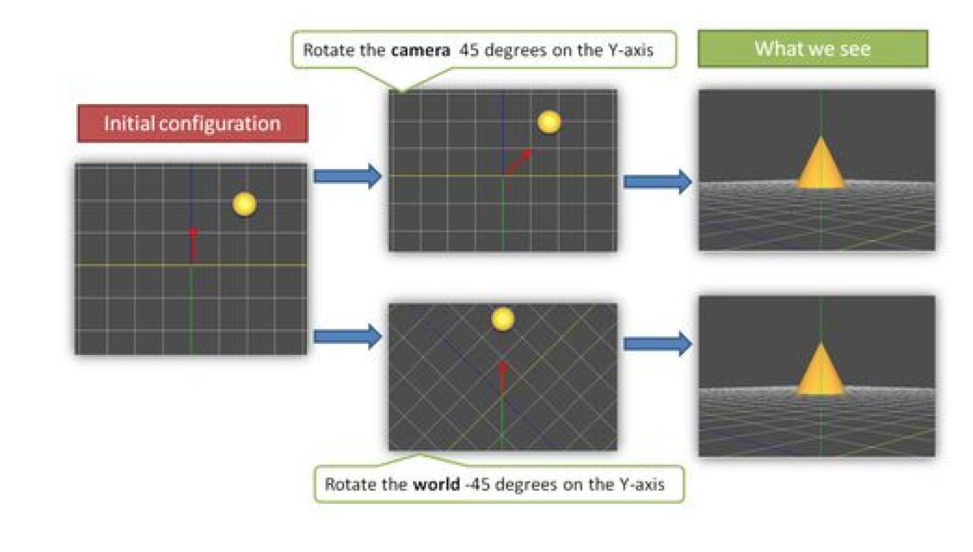
Example
From WebGL Beginner’s Guide by Cantor and Jones

Slide 23
Viewing Transformation
Model Coords
Model Xform
World Coords
Viewing Xform
Viewing Coords
Perspective Distortion
Homogeneous Divide
Still Clip Coords.
Clipping
Clip Coords.
Window
Coordinates
Window
to
Viewport
Viewport
Coordinates

Slide 24
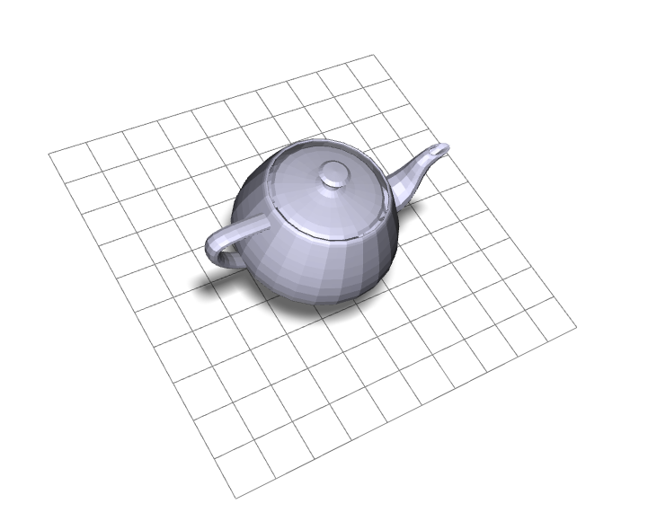
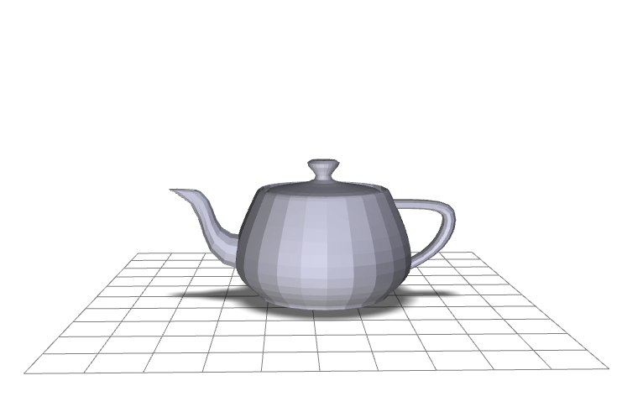
Viewing Transformation
eye point
lookat point
y
y
x
x
z
Screen Coords
Clip Coords
Viewing Coords
World Coords
Model Coords

Slide 25
Creating a Camera Function
Suppose we want to implement a function that sets up view …think of it as setting up a camera
There are lots of possible ways to do this…we’ll choose a simple lookat camera
The API we create will require a someone using the function to specify:
The eyepoint (or camera location)
The lookat point (a point in the view direction)
An ”up” vector that we use to specify rotation around the view vector

Slide 26
Deriving the Viewing Transformation
One way to think about what you are doing
Translate the eyepoint to the origin
Rotate so that
lookat vector aligns with
–z axis for right-handed coordinate systems
+z axis for left-handed systems
up aligns with y
We move all objects (the world) this way…
Another way to think of it
Create an orthonormal basis with eye at the origin
And vectors u, v, w as the basis vectors
…and then align u,v,w with x,y,z

Slide 27
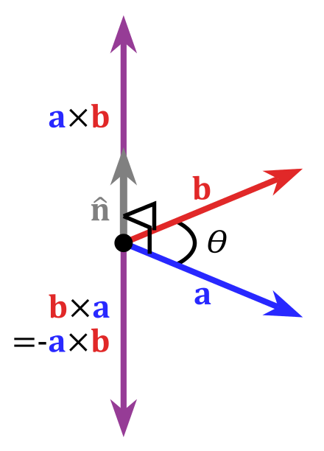
Cross Product of Two Vectors
Important Property: The cross product yields a vector orthogonal to the original two vectors

Slide 28
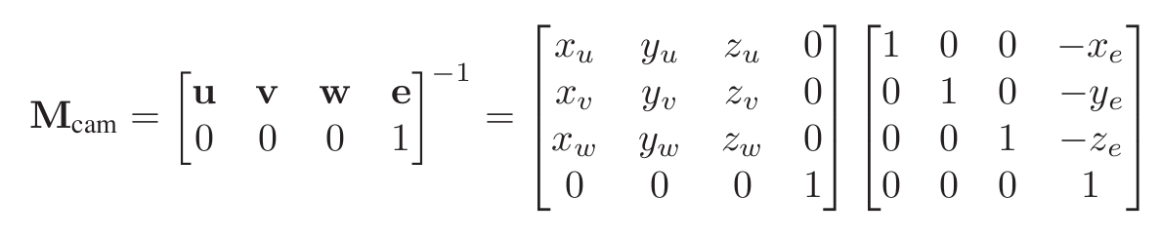
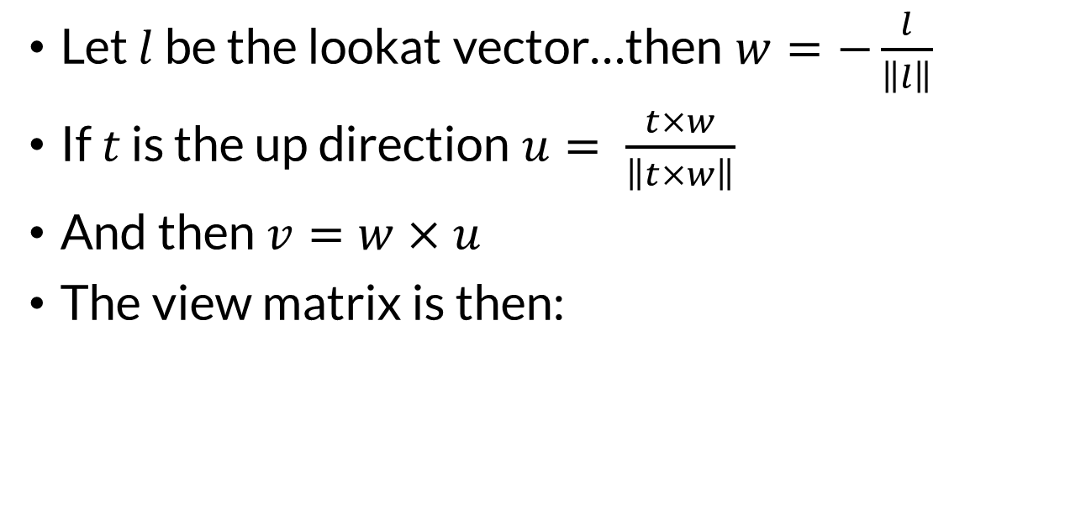
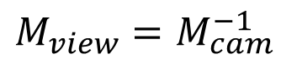
The Orthonormal Basis for View Space
This derivation assumes an right-handed coordinate system and view down the –z axis…how could we change it to look down +z?
Let $l$ be the lookat vector…then $w=−\frac{l}{\left\|l\right\|}$
If $t$ is the up direction $u= \frac{t×w}{\left\|t×w\right\|}$
And then $v=w×u$
The view matrix is then:
$${M_{view}=M}_{cam}^{−1}$$
Why is the matrix inverted?

Slide 29
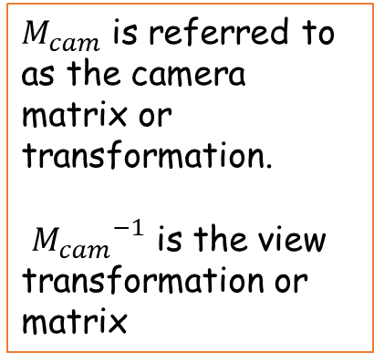
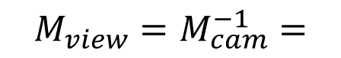
View Transformation
$M_{cam}$ is referred to as the camera matrix or transformation. ${M_{cam}}^{−1}$ is the view transformation or matrix
You can now look at your scene from any
Position
Orientation (almost)
What lookat and up vector pair won’t work?
…just uses a matrix multiplication
$${M_{view}=M}_{cam}^{−1}=$$

Slide 30
Projection

Slide 31
Mathematics of Projection
Eye coords = view coords

Slide 32
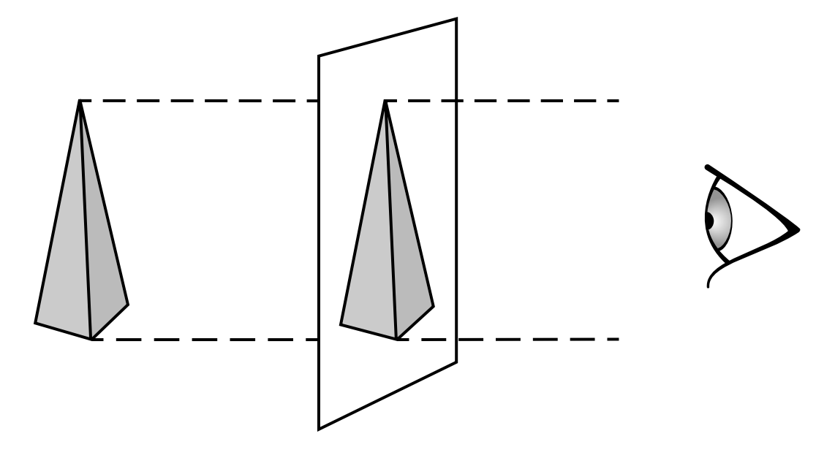
Orthographic Projection

Slide 33
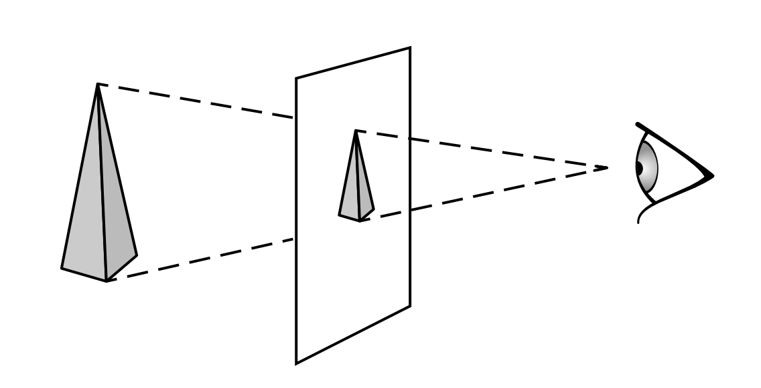
Perspective Projection

Slide 34
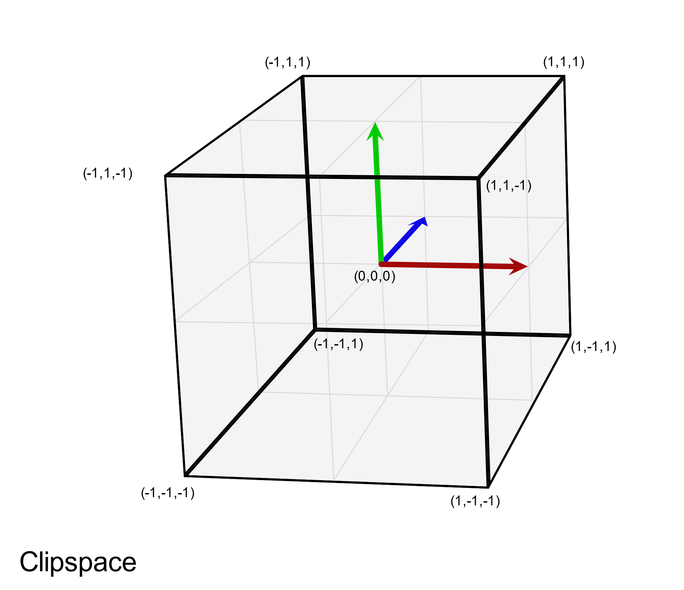
The Canonical View Volume
View is looking down Z+
Eyepoint is effectively at (0,0,-1)
This is a left-handed coordinate system

Slide 35
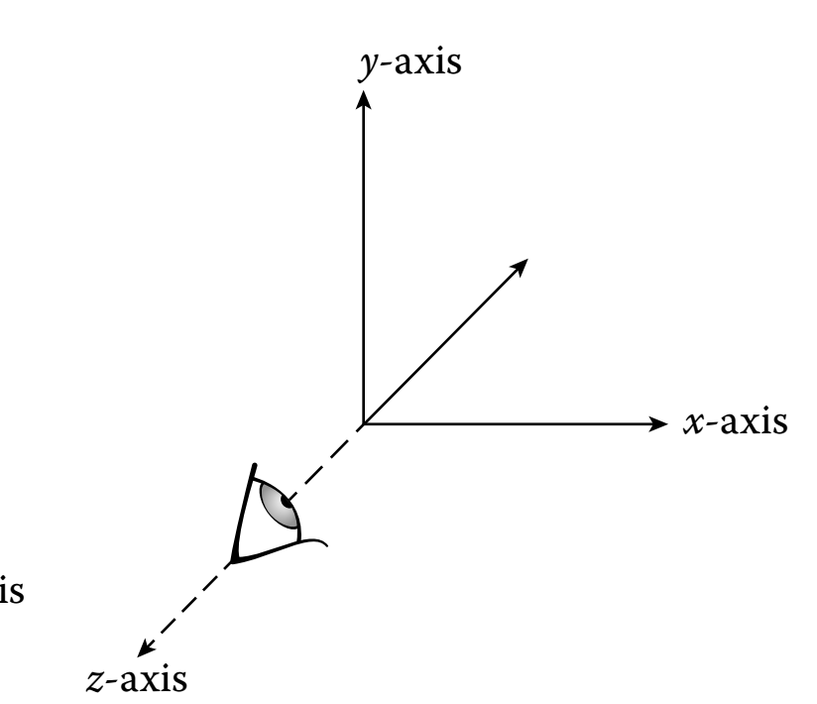
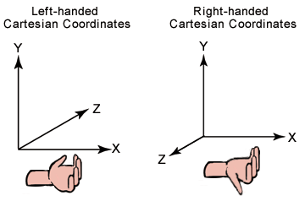
WebGL Style View
WebGL/OpenGL convention is to assume a right-handed world coordinate system
The ortho matrix is used to flip this coordinate system by scaling Z by -1
It then matches WebGL clip space

Slide 36
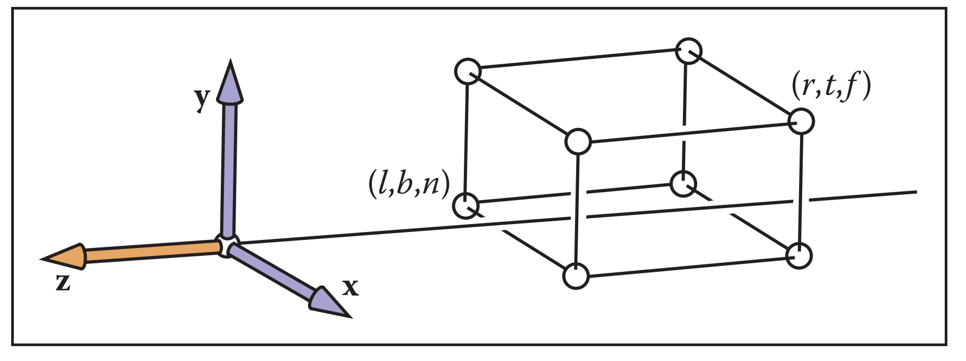
More Rasterization Secrets
Model Coords
Model Xform
World Coords
Viewing Xform
Viewing Coords
Perspective Distortion
Still Clip Coords.
Clipping
Clip Coords.
Homogeneous Divide
Window
Coordinates
Window
to
Viewport
Viewport
Coordinates
Typical rasterization engines only perform an orthographic projection
Everything is projected to the z=0 plane in the normalized view volume
But you can distort your geometry to achieve a perspective projection
The actual projection occurs when the geometry is in Normalized Device Coordinates (NDC)
Even then, depth information is kept around to do hidden surface removal
Depth information means transformed z coordinates

Slide 37
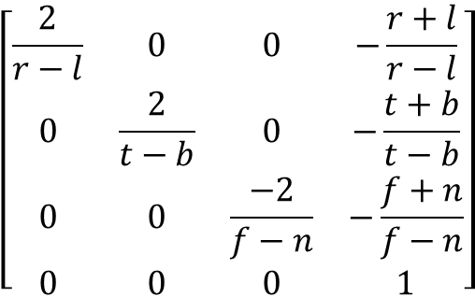
Orthographic Projection
View Volume
(left,top,-near)
y
Foreshortens
No change in size by depth
Classic Orthographic Projection matrix simply zeros the z- coordinate
The OpenGL ortho matrix has 6 parameters: out,left,right,bottom,top,near,far
-z
z
x
(right,bottom,-far)
Viewing Coordinates
Ortho
Clip Coordinates
$$\left[\begin{matrix}\frac{2}{r−l} & 0 & 0 & −\frac{r+l}{r−l} \\ 0 & \frac{2}{t−b} & 0 & −\frac{t+b}{t−b} \\ 0 & 0 & \frac{−2}{f−n} & −\frac{f+n}{f−n} \\ 0 & 0 & 0 & 1\end{matrix}\right]$$
Does the ortho matrix perform a projection?

Slide 38
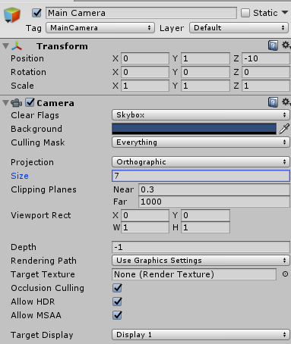
Orthographic Camera in Unity
The Size parameter sets the left, right, and top, bottom clipping planes
The near and far planes are set explicitly.

Slide 39
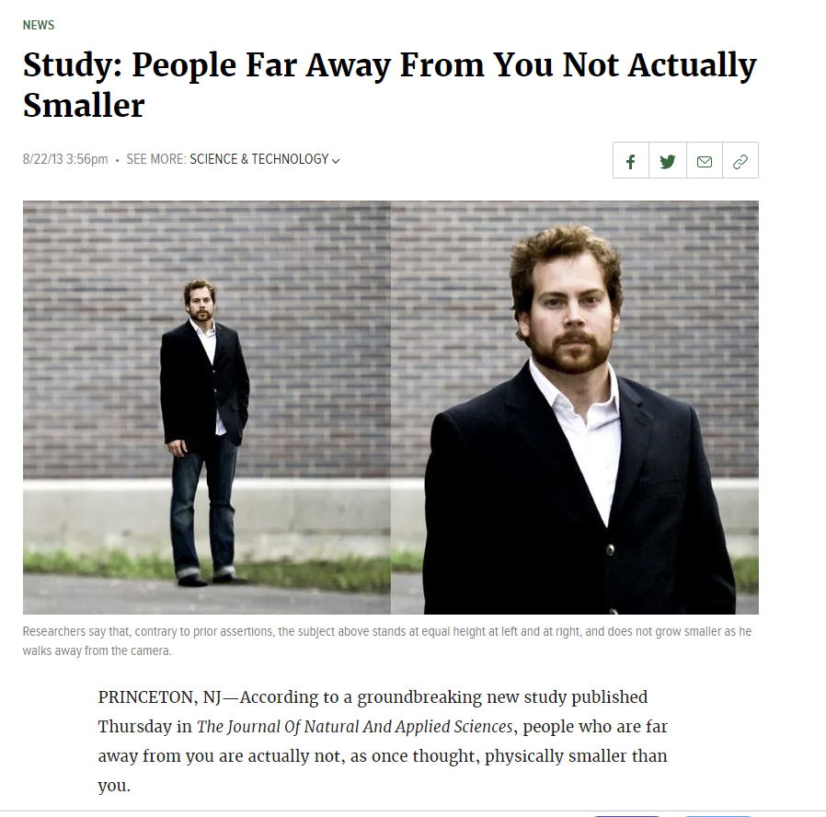
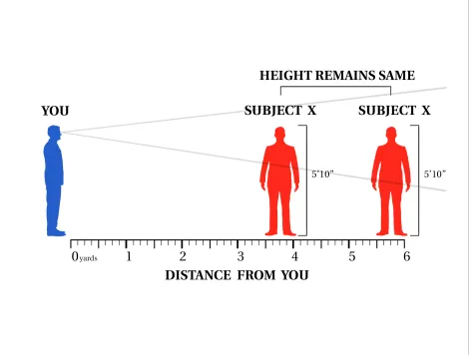
Perspective Projection
Actually…to accomplish a perspective projection, we will shrink far-away objects….
This graphical representation explains the research team’s central hypothesis

Slide 40
Mathematics of Perspective
screen
y
y_{view}
y_{clip}
-z
z_{view}
d
Eye is at origin (0,0,0)
Screen is distance d from the eye.
Looking down negative z-axis.
The two triangles are similar (two angles are obviously congruent)
This means corresponding sides are in the same proportions

Slide 41
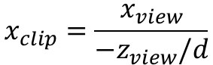
Mathematics of Perspective
screen
x
x_{view}
x_{clip}
-z
z_{view}
d
Same process derives the projection for the x coordinate.
What is z_{clip}?
$$x_{clip}=\frac{x_{view}}{{−z}_{view}/d}$$

Slide 42
Projections Using Homogeneous Coordinates
We can extend our use of homogenous coordinates to handle projections
Let the fourth homogeneous coordinate be any non-zero value w
To find the point it corresponds to:
multiply all four coordinates by 1/w
When homogeneous coordinate is zero
Denotes a “point” at infinity
Represents a vector instead of a point
Not affected by translation
A point in 3D corresponds to what in the 4D homogenous space?

Slide 43
Simple Perspective
screen
y
y_{view}
y_{clip}
-z
z_{view}
d
By allowing w to change we represent more kinds of transformations

Slide 44
Perspective Projection in Rasterization
Just like with parallel viewing we will
Define a viewing volume
Construct a normalization transformation
We turn a perspective projection into orthogonal projection

Slide 45
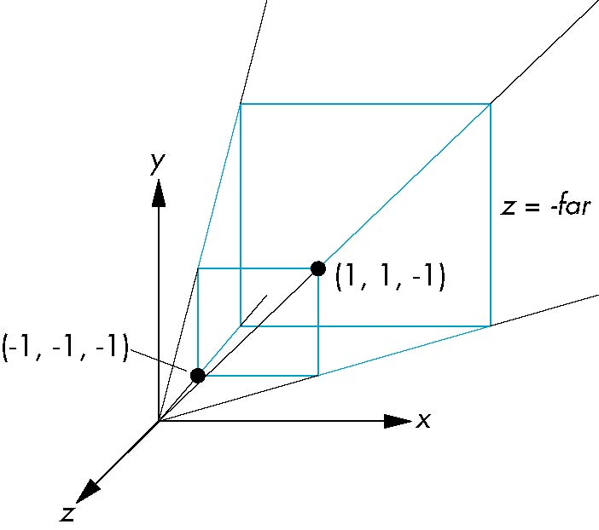
Perspective Normalization
Consider a simple perspective view with:
the center of projection at the origin
the near clipping plane at z = -1
and a 90 degree field of view determined by the planes x = ±z, y = ±z

Slide 46
Perspective Matrices
Simple projection matrix in homogeneous coordinates
Note that this matrix is independent of the far clipping plane
M =

Slide 47
Generalization
after perspective division, the point (x, y, z, 1) goes to
x’ = -x/z
y’ = -y/z
z’ = -(α+β/z)
N =

Slide 48
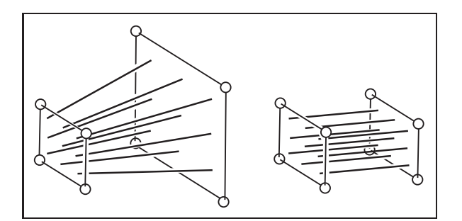
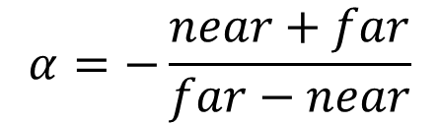
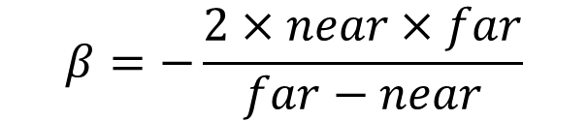
Picking α and β
If we pick
$$α=−\frac{near+far}{far−near}$$
$$β=−\frac{2×near×far}{far−near}$$
the near plane is mapped to z = -1
the far plane is mapped to z = 1
the sides are mapped to x = ± 1, y = ± 1
The new view volume is the default clipping volume

Slide 49
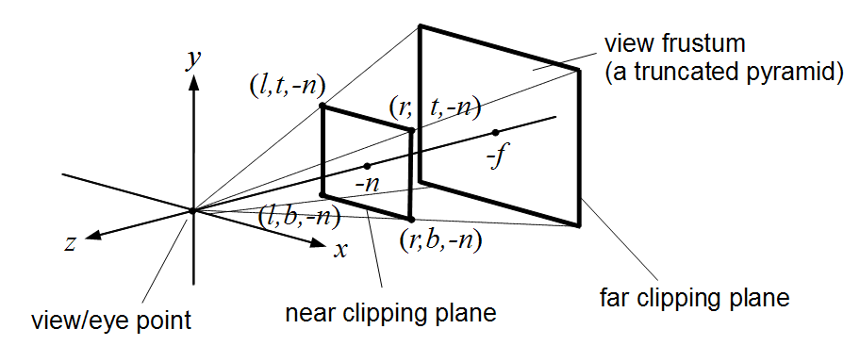
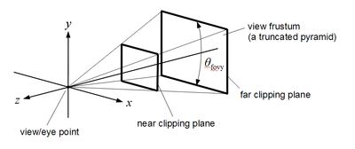
Example: WebGL Perspective
mat4.frustum allows for an asymmetric viewing frustum using left, right, bottom, top, near, far
mat4.perspective generates a symmetric frustum using fovy, aspect, near, far fovy → vertical viewing angle in radians
aspect → aspect ratio of the viewport
near → distance from center of projection to near clip plane
far → distance from center of projection to far clip plane it computes a frustum with right=top x aspect top = near x tan(fovy) left = -right and bottom = -top

Slide 50
Perspective Matrices
frustum
perspective

Slide 51
The viewport transformation
Moves from 2D canonical coordinates
x in [-1,1] and y in [-1,1]
To viewport coordinates
Integer pixel coordinates
We can do this!
What affine transforms do we need?

Slide 52
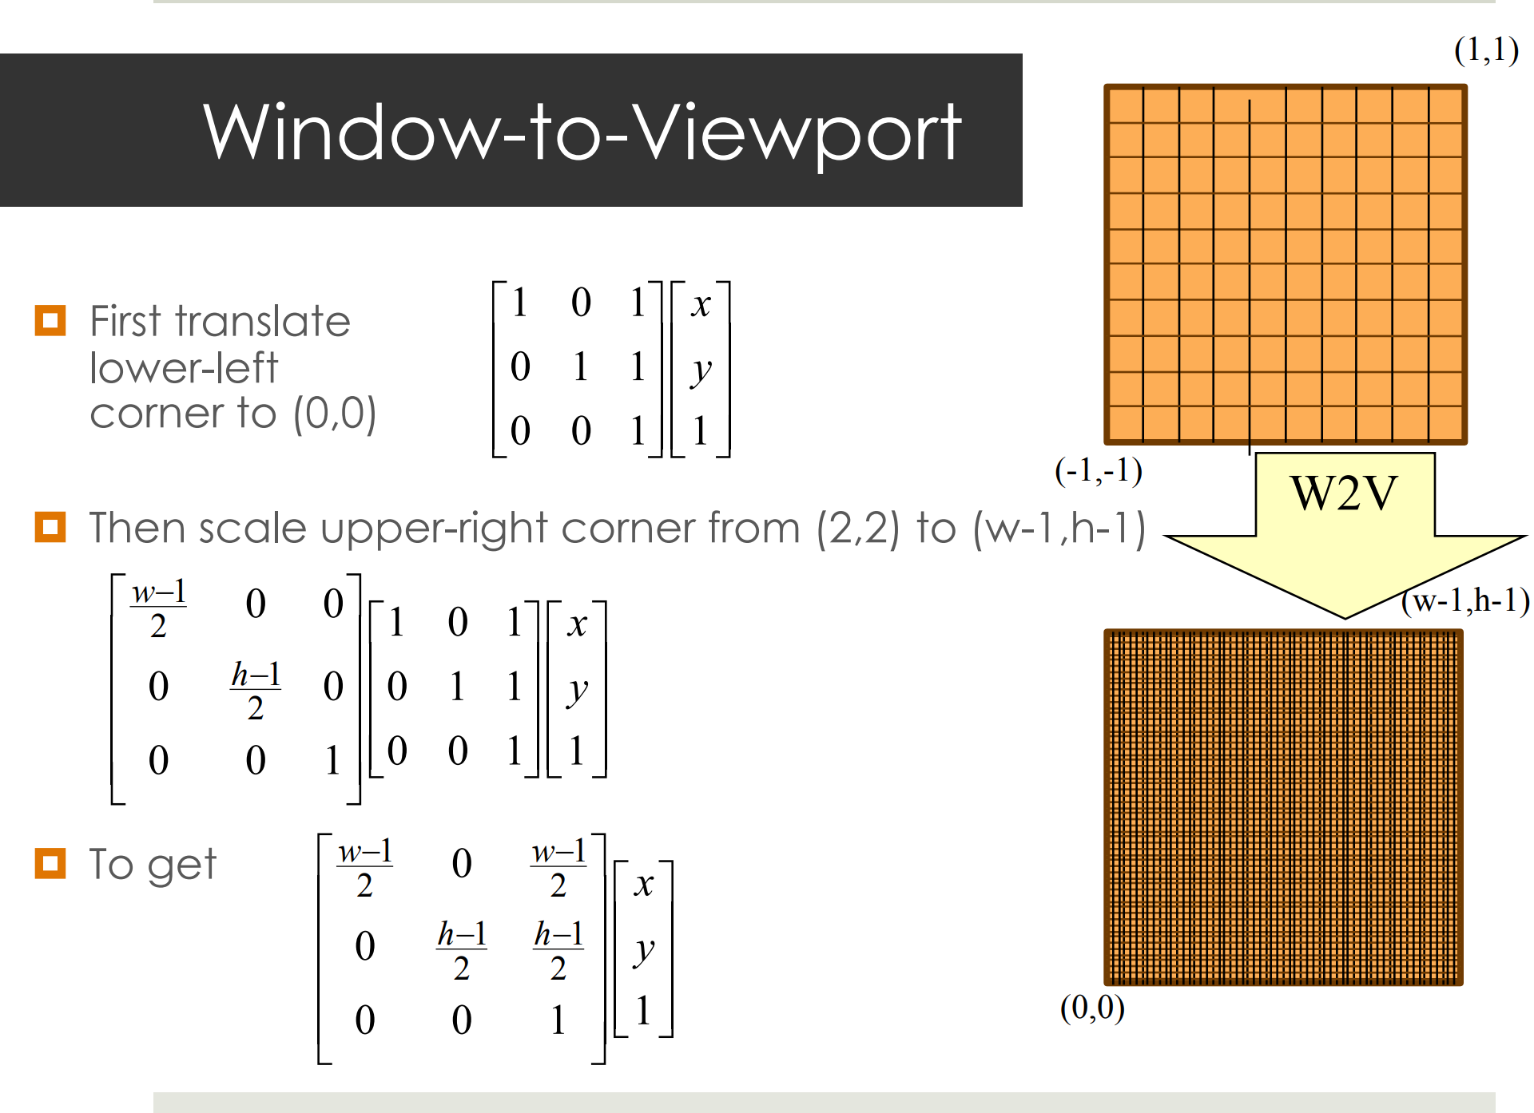
The viewport transformation

Slide 53
Let’s review the rasterization pipeline
We start out by setting up our geometry in world coordinates
Which transformation does this?

Slide 54
The view transformation
We pick a specific viewing position and direction in worldspace

Slide 55
The view transformation
Actually…in Unity we use a lefthanded coordinate system and look down the +z axis
We transform the world so the view position is at the origin. For a right-handed coordinate system, the view direction is down the –z axis

Slide 56
The projection transformation
We pick a viewing volume. This is specified in viewing coordinates.

Slide 57
The projection transformation
The WebGL view volume is a box with clip planes at -1, +1
The z coordinates are negated to flip the z-axis
Our view volume is transformed to fit in the canonical view volume.
Is this actually a projection?

Slide 58
Actual projection….
The rasterization engine does an orthographic projection of the view volume contents to 2D

Slide 59
Graphics Pipeline
Model Coords
Model Xform
World Coords
Viewing Xform
Viewing Coords
Perspective Distortion
Homogeneous Divide
Still Clip Coords.
Clipping
Clip Coords.
Window
Coordinates
Window
to
Viewport
Viewport
Coordinates

Slide 60
Graphics Pipeline
Model Coords
Model Xform
World Coords
Viewing Xform
Viewing Coords
Perspective Distortion
Homogeneous Divide
Still Clip Coords.
Clipping
Clip Coords.
Window
Coordinates
Window
to
Viewport
Viewport
Coordinates
M

